Slide 1

Specialization, concentration and agglomeration measurement: distance-based vs. cluster based Katarzyna Kopczewska Faculty of Economic Sciences, University of Warsaw The paper is financed by the Polish National Science Centre www.ncn.gov.pl as the research project in OPUS 6 call, contract No. UMO-2013/11/B/HS4/01098

Slide 2
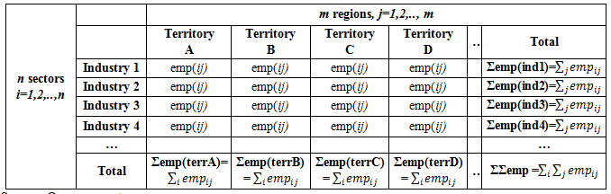
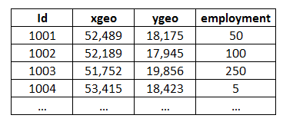
Background (1)
Specialization, concentration and agglomeration are typically measured in two-ways:
With the functions based on aggregated data (cluster-based measures)
With the functions based on point data (distance-based measures)

Slide 3
Background (2)
Current regional literature is very rich in measures of first type (cluster-based):
As they have been invented and improved for last 100 years
As they are based on easily accesible data
As they are easy in calculation and interpretation
But…
they do not give an insight into „cell” – employment in given sector in given region is characterised with single number (total) and nothing else is available
Usually they fail with MAUP
→ Multitude of measures available needs some guidance what to use
This is the first goal of the presentation: to present how they work!

Slide 4
Background (3)
Second type of measures (distance-based) are just developing:
as the geo-localised individual datasets were not widely available
as the computational power of computers was too weak
But….
- There are just few approaches – in fact we are looking for good measures
This is the second goal of the presentation:
to present how they work!

Slide 5
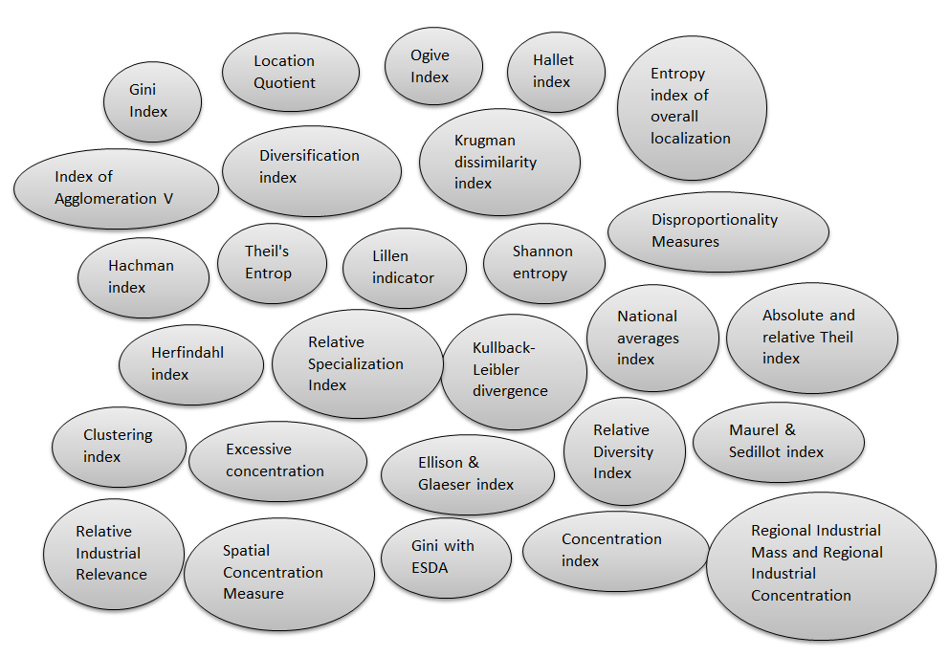
Cluster-based measures typology (1)

Slide 6
Cluster-based measures typology (2)
Do they give the same information?
What is the value added of using all of them?
?

Slide 7
Cluster-based measures typology (3)
Measures of sectoral concentration (distribution of activity between sectors within the region) | Measures of geographical concentration (distribution of activity between regions withing the sector)
NAI, KLD, Lilien (dynamic index), Ogive index, Theil S, refined diversification index, Krugman index, Hallet index, Gini index, RSI (max LQ), Herfindahl index Relative Diversity Index (RDI) (inverse Krugman), Hachman index, Absolute Diversity Index (ADI) (inverse HH), Shannon entropy, Relative H | Gini index, Krugman index, Bruhlart & Traeger index, locational Gini, Guillain & LeGallo (Moran I for LQ), Ellison-Glaeser index, Agglomeration V, clustering index (Bergstrand) KLD, Maurell-Sedillot index
overall concentration measures for whole economy | measures for single “cell” /for sector in region/
Geographic concentration index, Theil total | Location Quotient

Slide 8
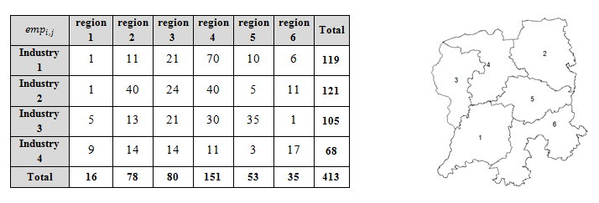
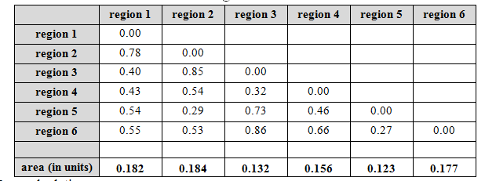
Example data
Let’s assue example data as follows:
And distance matrix:

Slide 9
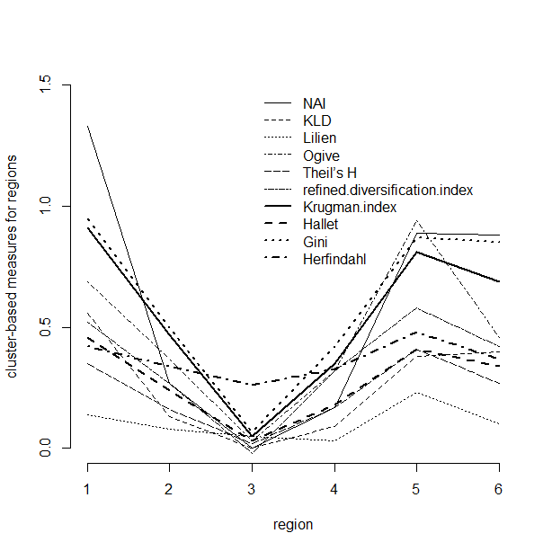
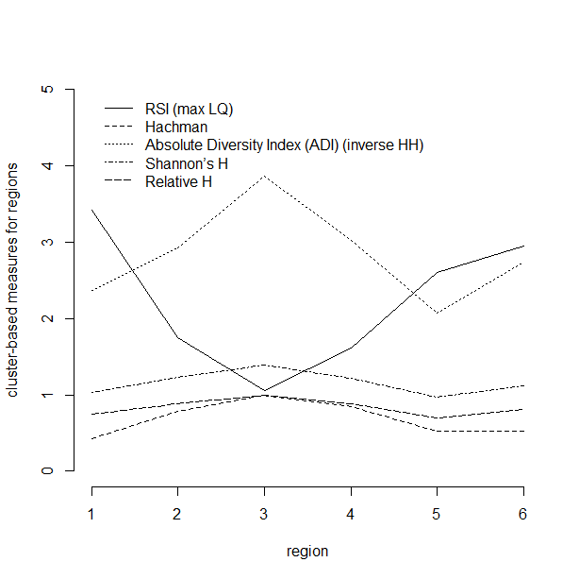
Results: Sectoral concentration indicators for example data
Correlations and common trends are visible, but sample is too small to conclude

Slide 10
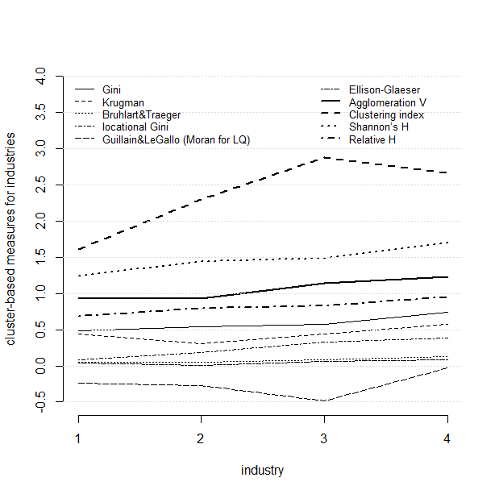
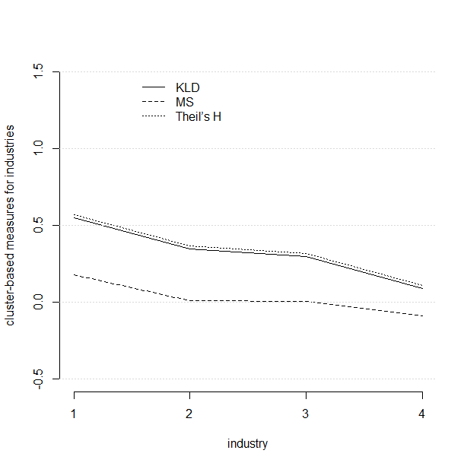
Results: Geographical concentration indicators for example data
Correlations and common trends are visible, but sample is too small to conclude

Slide 11
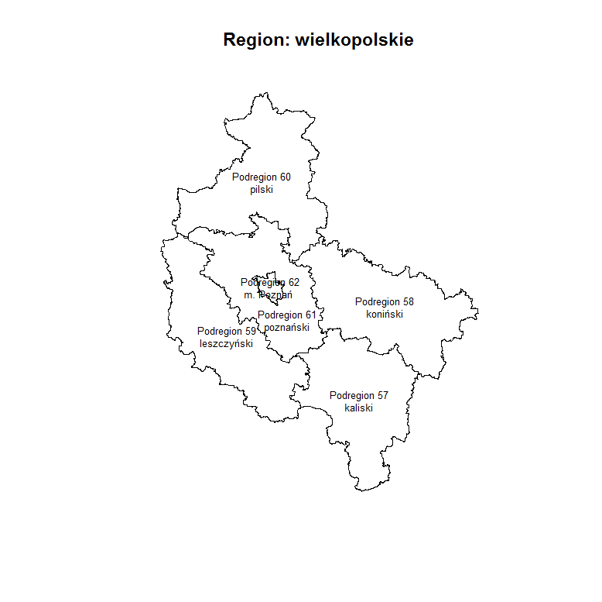
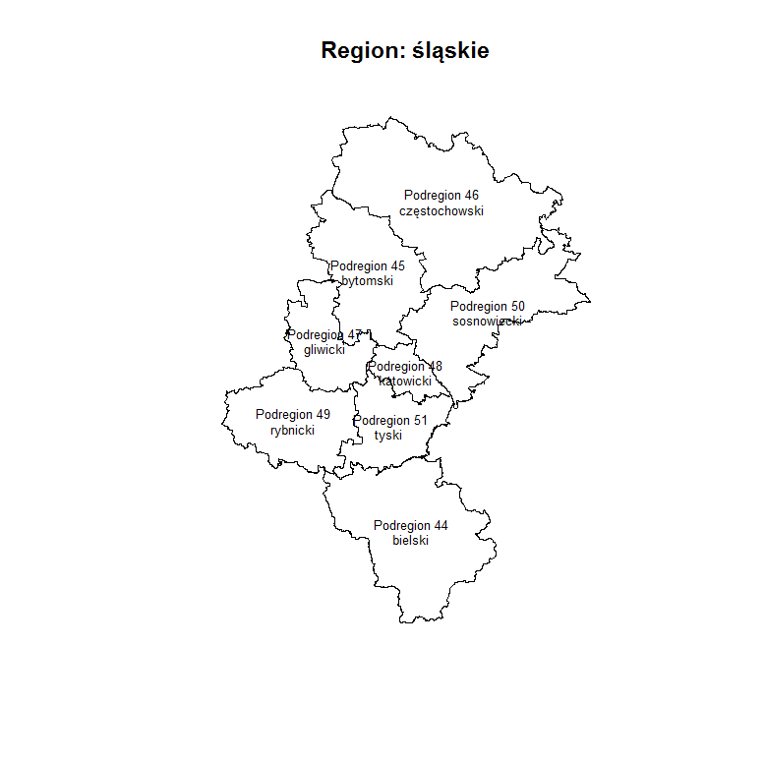
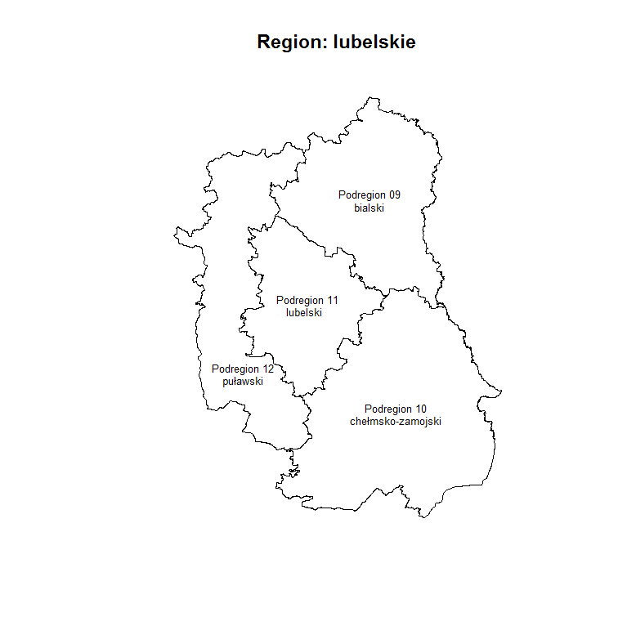
Let’s repeat the analysis on real data (1)
Let’s take real data – real point locations of business for macro-regional economies → for NTS2 regions and their NTS3 subregions

Slide 12
Let’s repeat the analysis on real data (2)
Let’s take real data – real point locations of business for macro-regional economies → aggregate them by regions and sectors and count employment
 |  | Grups of employment
Section (from A to S) | NTS2 Region | 1 Small firms up to 5 people | 2 Middle firms up to 30 people | 3 Middle-big firms up to 150 people | 4 Big firms up to 600 people | 5 Very big firms up to 1500 people | Total number
A | Wielkopolskie Śląskie Lubelskie | 134 992 62 495 207 090 | 598 147 151 | 119 22 16 | 6 6 1 | 0 0 0 | 135 715 62 670 207 258
B | Wielkopolskie Śląskie Lubelskie | 423 416 199 | 24 100 12 | 4 38 0 | 2 13 4 | 2 2 18 | 455 569 233
C | Wielkopolskie Śląskie Lubelskie | 34 465 37 081 12 227 | 3 257 3 983 747 | 923 691 188 | 164 314 46 | 23 23 0 | 38 832 42 092 13 208
 | …
Total amount (number of firms) | Wielkopolskie Śląskie Lubelskie | 508 881 481 059 366 152 | 15 887 19 870 5 603 | 3 080 3 359 1 240 | 364 581 84 | 70 48 35 | 528 282 504 927 373 114

Slide 13
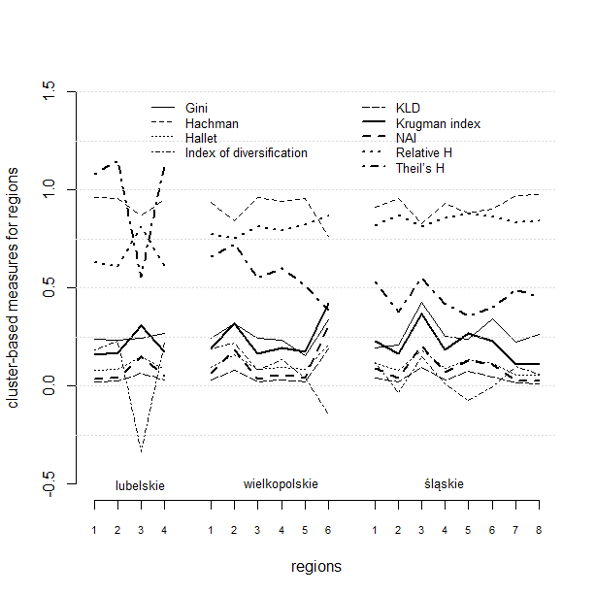
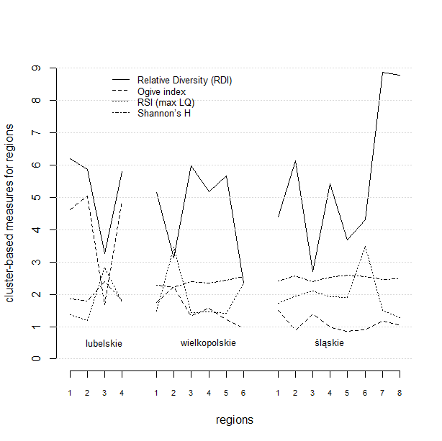
Results: Sectoral concentration indicators for real data

Slide 14
Comparison of sectoral concentration cluster-based measures (1)
1 → Comparing the level of indicator and its variance among regions
This may give an intuition of what values are obtainable, even if limits are defined. One should remember than for some of the indicators there is no upper border defined in the literature, and having no reference point may be misleading in interpretation.
2 → Inter-relations between measures
Are they correlated and provided with the same information, or do they give different results? On the basis of Pearson correlations in groups for NTS2 regions, we divide the indicators for similar groups. We check if the division into groups is stable and robust.
3 → What information we gain from this analysis
We interpret briefly results within the groups of measures. What is important is that we always look at the cell (employment in the region in the sector), and its relations to other cells. With these measures it is impossible to look inside the cell.

Slide 15
Comparison of sectoral concentration cluster-based measures (2)
1 → Measures have different variances – the lowest in the case of the Hallet measure (v=0.06) and entropy measures, Relative H and Shannon’s H (v=0.11), and the highest variance is in case of NAI (v=2.26), than Gini (v=0.89) and RDI (v=0.8).
Variance of measures gives the sensitivity of indicators. → Indices with high variability are predisposed to distinguish different patterns in more efficient ways than the low-variance measures.

Slide 16
Comparison of sectoral concentration cluster-based measures (3)
2 → Correlations between measures - there are four mostly homogenous groups of measures, which can be separated with the Pearson correlation coefficient.
A high correlation between measures results from the same benchmark distribution.
The first group consists of: Relative H, Ogive index, Theil’s H, Shannon’s H and the index of diversification. These measures mostly behave similarly, in the same or opposite direction (very strong positive or negative correlation).
They have as benchmark the uniform industrial distribution (equal shares)
The second group includes the measures: National Averages Index (NAI), Relative Diversity Index (RDI), Hachman index, Hallet index, KLD and Krugman dissimilarity index. Again, they behave similarly, in the same or opposite direction.
They have as benchmark the empirical industrial distribution.
The third and fourth group are the Gini index and RSI. Their pattern is different from other groups.
Gini: compares regional and national structures, but inclusdes the rank values and average over- / under-representation of regional to national structure
RSI: it is in fact the maximum LQ in the region, It measures “winner-takes-all” of LQ.

Slide 17
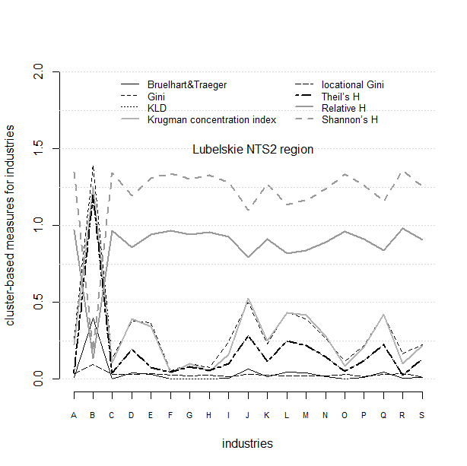
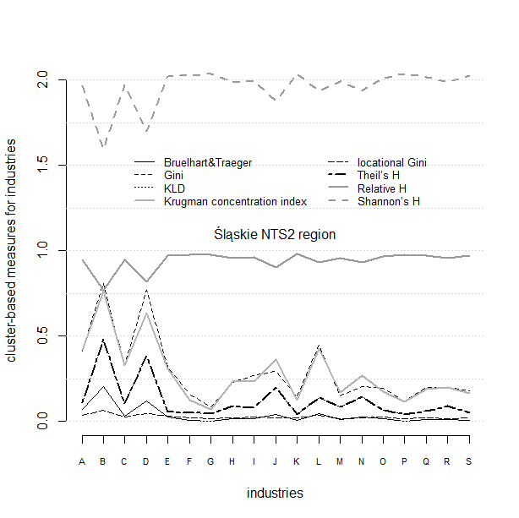
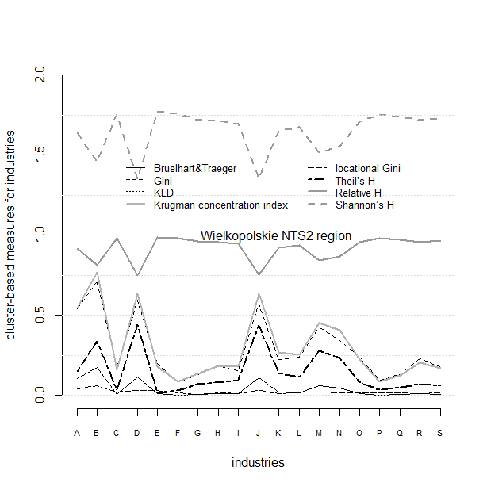
Results: geographical concentration indicators for real data
…..

Slide 18
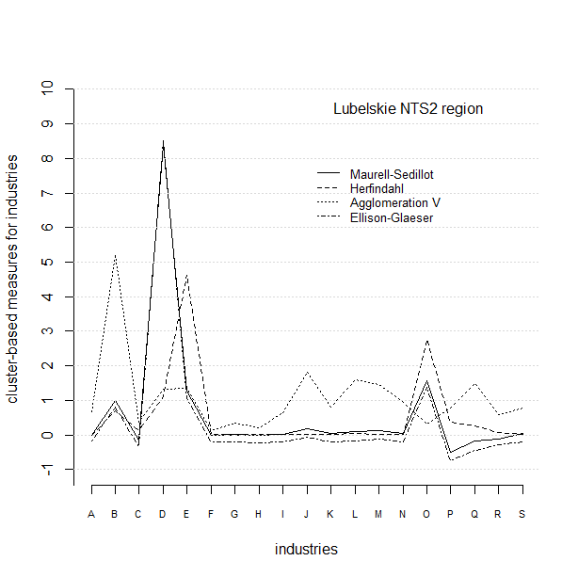
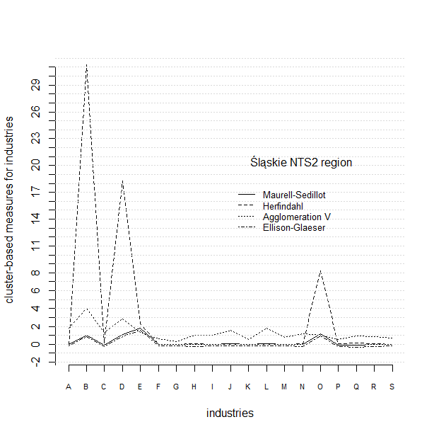
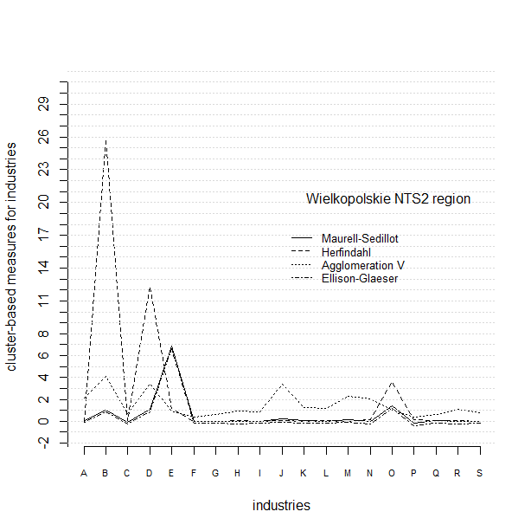
Results: geographical concentration indicators for real data
…..

Slide 19
Comparison of geographical concentration cluster-based measures (1)
Measures have different benchmark distributions and behave similarly within these groups.
- Gini, locational Gini, Krugman concentration index, Bruelhart & Traeger index and Agglomeration V refer to empirical geographical concentration in the whole economy.
- Four entropy measures: Shannon’s H, Relative H, Theil’s H and KLD, refer to uniform distribution (equal shares).
- EG and MS, because of their construction, follow other patterns than measures above.
→ Sectoral concentration measures can select industries with the biggest share in the economy.
→ Geographical concentration measures can test the inter-regional allocation of business and which region could attract more/less of industry than other regions.
BUT…… Agglomeration measures such as SPAG can answer the question of what happens inside the region in terms of the spatial allocation of business, and can test the density of allocation.

Slide 20
So what?
This multitude of cluster-based measures:
answers the question on over-representation of sector within regional economy in reference to uniform distribution or whole economy (two measures are enough)
answers the question on inter-regional allocation of business and which region could attract more/less of industry than other regions (in reference to uniform distrubution or whole economy) (two measures are enough)
They do not answer the question what happens inside the cell (the distribution of business within single sub-region). Even equal allocation among subregions may end up with extreme agglomeration in single points in these subregions… this is not visible with these measures.
They also do not answer what is the specialization of the region! Thus they should be named sectoral concentration and geographical concentration measures!

Slide 21
What next?
Distance-based measures can give the insight what happens in space withing subregions
Please see next session: FRI_2_TC.4.02 → Spatial agglomeration measures (SPAG) in action on real data for Poland (almost 1,5 mln geo-referenced points analysed)
What for do we need it? For regional specialisation policy analysis
Please see next session : FRI_2_TC.4.02 → Towards the interpretation of regional specialisation: Economy and policy perspective
Full analysis, interpretation as well as the guide on these measures will be available in book: Measuring Regional Specialisation – A New Approach by Katarzyna Kopczewska
Paweł Churski, Artur Ochojski, Adam Polko (palgrave macmillan / Springer, forthcoming in 2017)

Slide 22
Specialization, concentration and agglomeration measurement: distance-based vs. cluster based Katarzyna Kopczewska kkopczewska@wne.uw.edu.pl
Thank you!

